Slide 1
[20260805] PCCP Topic #1 Brute Force AX Development Team Nguyen Thi Binh An

Slide 2
PCCP Introduction

Slide 3

Overview
Programmer Coding Competency Certification
Way for LG CNS validating coding competence
Focus on problem solving (DSA)
Paint points
Code on web browser without IDE
Just provide sample cases
Require requirements analysis, coding, testing, debug skills

Slide 4
Contest Scope
4 problems in 2 hours
Level 1-2-3 from https://school.programmers.co.kr/
Data Structures and Algorithms:
Array / String / Greedy / Sorting
Stack / Queue / Deque / Hash / Binary Search / DFS – BFS
Graph / Tree / Heap / Dynamic Programming
…

Slide 5

Personal Experience
Be familiar with 2 hours time scope
Be familiar with code without IDE or AI in about 30minutes
Console Log for debugging
Brute Force if possible (accept all cases is not required)
Figure out the way to handle problem base on required input
Start with small cases for thinking
Limit line of codes (you can not debug over 100 LoCs)

Slide 6
Very very personal…
If you want to be good at something, you have to do it yourself, make failure, and do it again, over and over…
Use pen and paper for visualization & simulation steps
Make your own cheatsheet
It’s okay to learn by heart
Time is money, use it wisely

Slide 7
PCCP Topic#1

Slide 8
Core Concepts
Data Structures
Array
Stack / Queue
Hash Map
Graph
Tree
Programing Skills
Logic Operations
Loop
Conditional
Function
Pointer
…

Slide 9
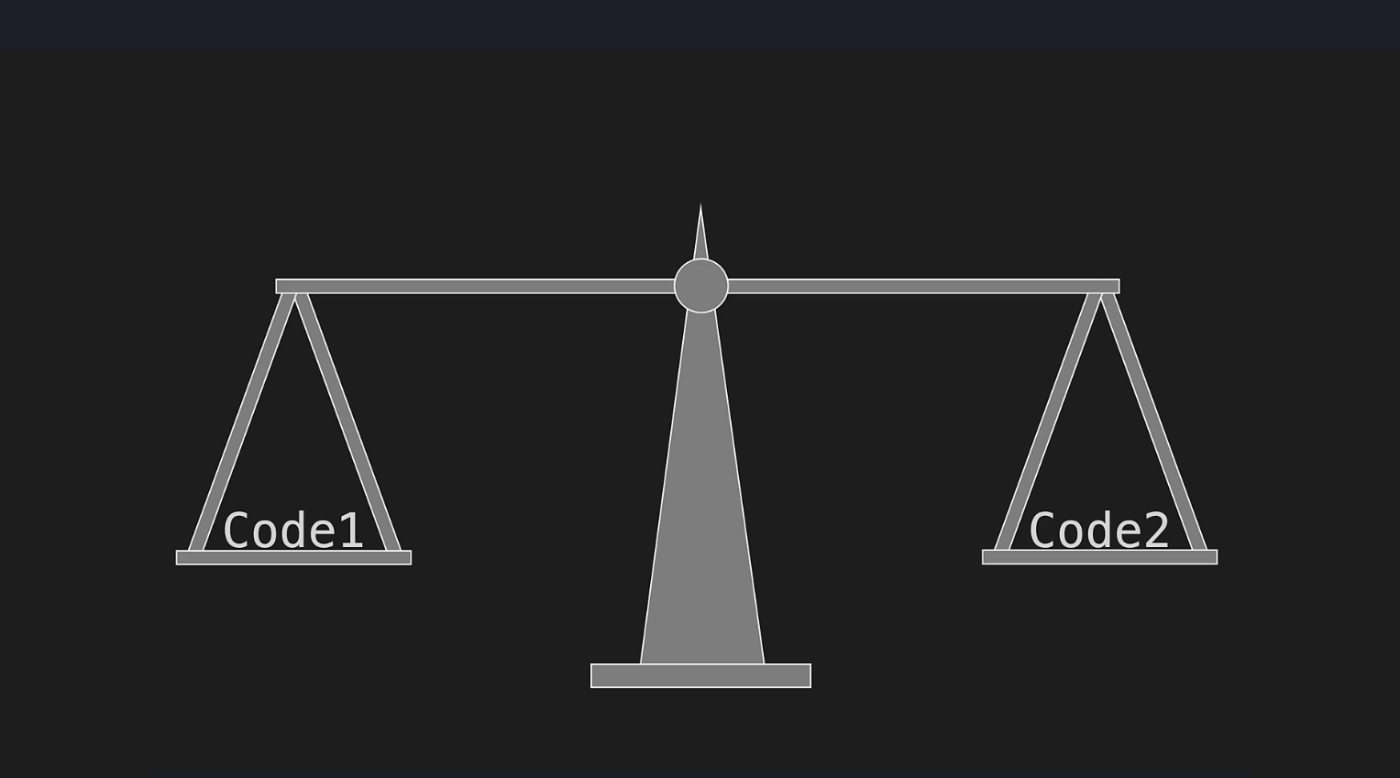

Slide 10
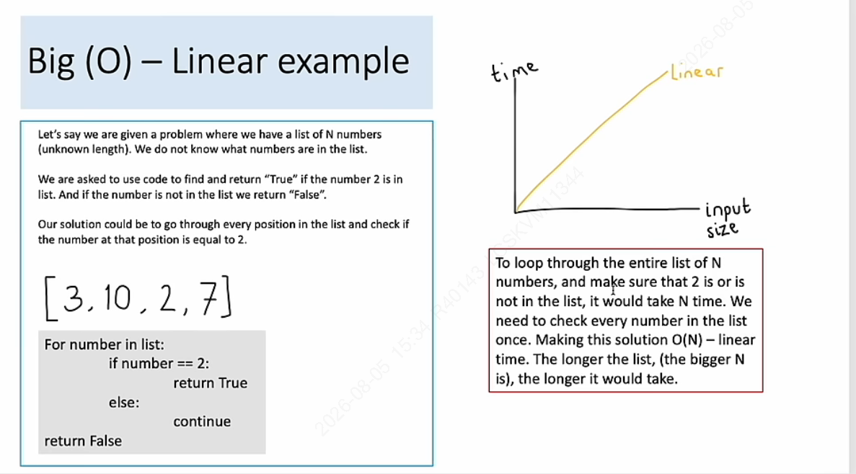

Slide 11
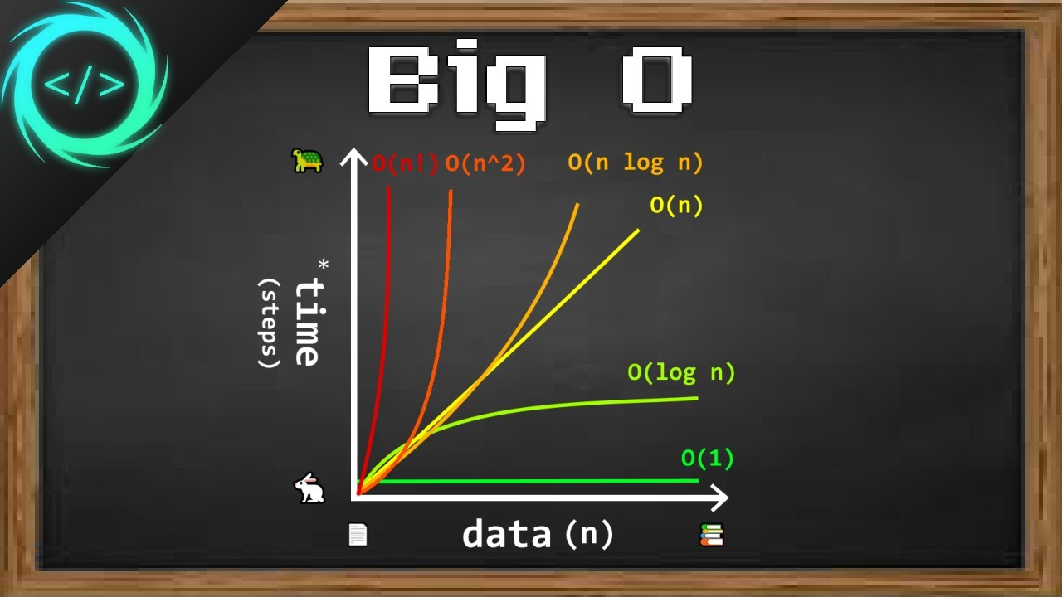
Core Concepts

Slide 12



Simple Example
10 | 11 | 12 | 13 | 14 | 15 | 16 | 18 | 19 | 20
Best Case
9
10
15
20
Linear Search
Worst Case
Binary Search
Average

Slide 13
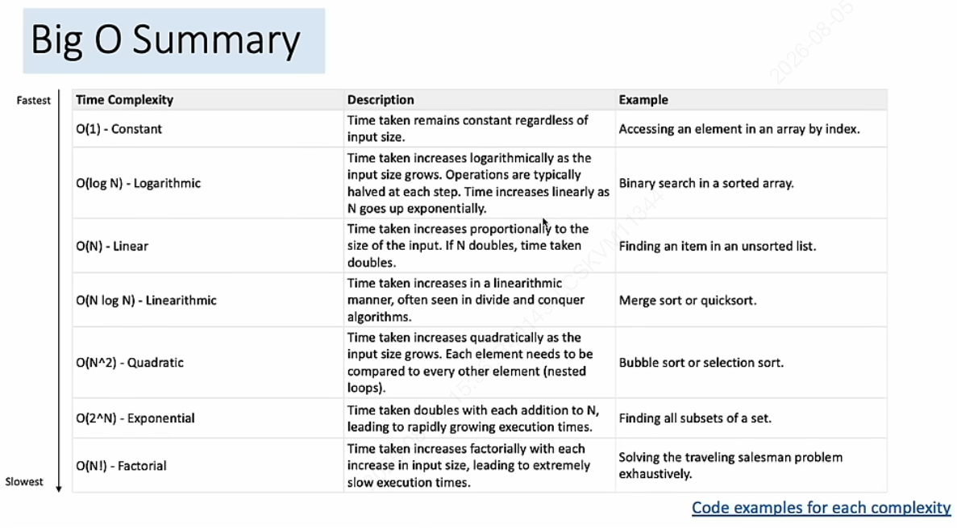
Average

Slide 14
Time for code..
Nguyen Thi Binh An
AX Development Team
an.ntb@lgcns.com

